Slide 1
Computer Graphics (L08)
EG678EX
2-D Algorithms

Slide 2
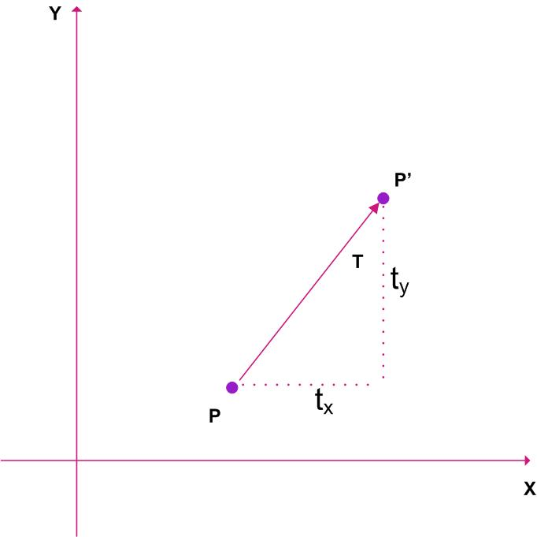

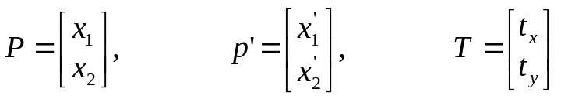

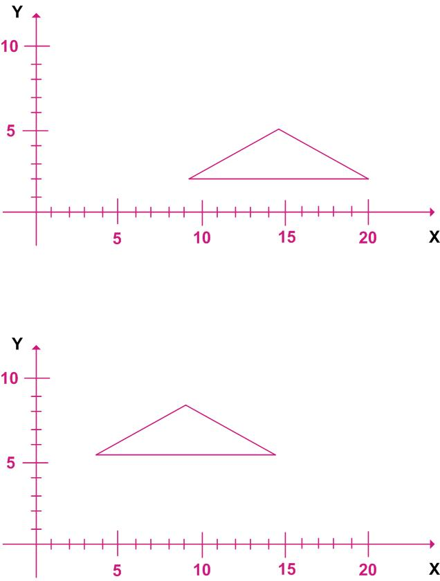
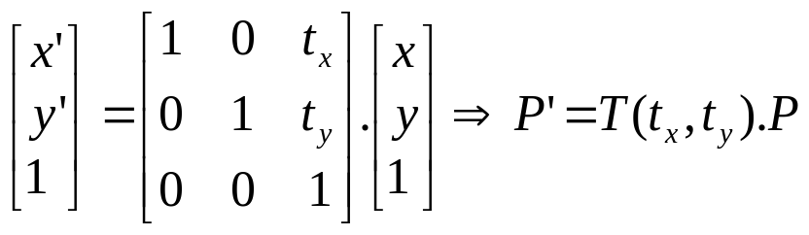
Translation
In homogeneous representation if position P = (x,y) is translated to new position p’= (x’,y’) then:

Slide 3
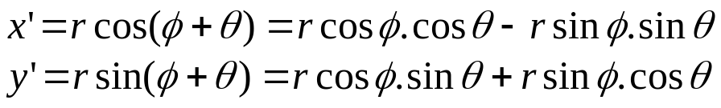
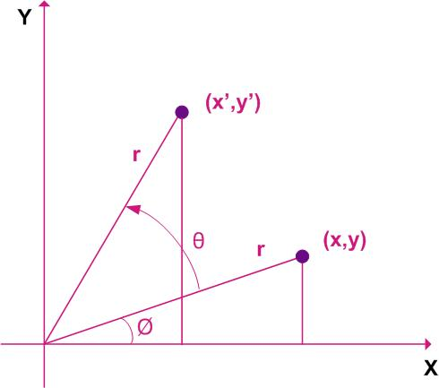

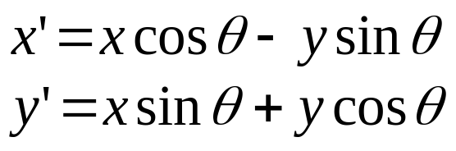
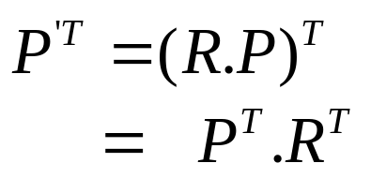

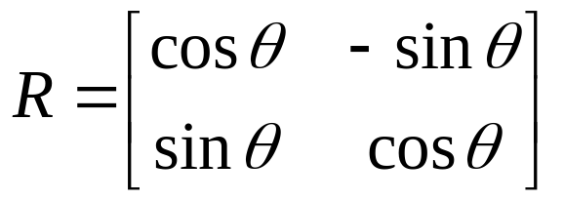
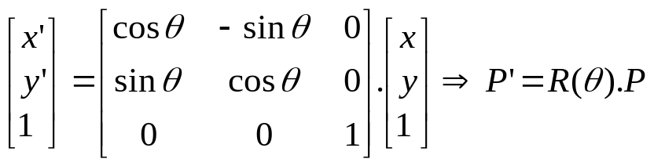
Rotation
If Co-ordinates represented as row vector, Then:
In homogeneous co-ordinate

Slide 4
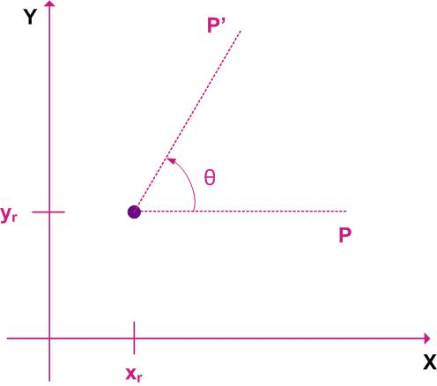
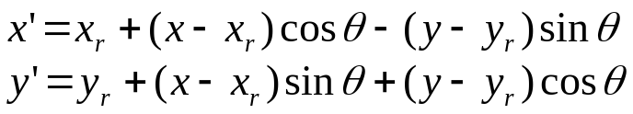
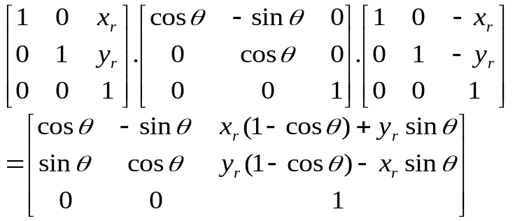
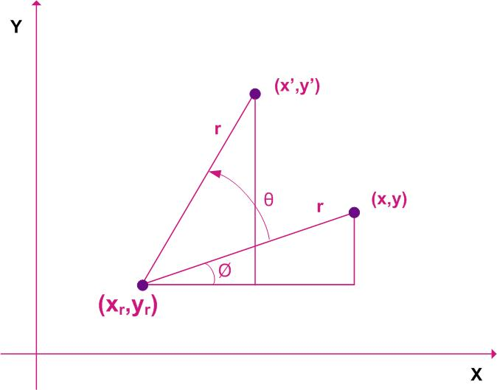
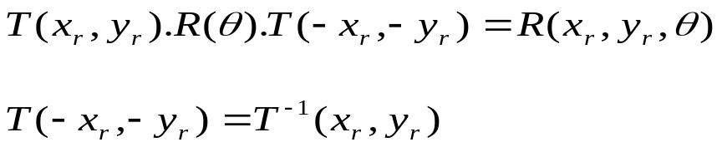
General Pivot Rotation
Steps
Translate object so as to coincide pivot to origin
Rotate object about the origin
Translate object back so as to return pivot to original position
Composite Transformations

Slide 5
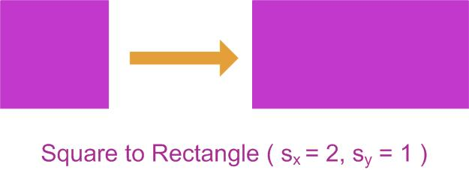
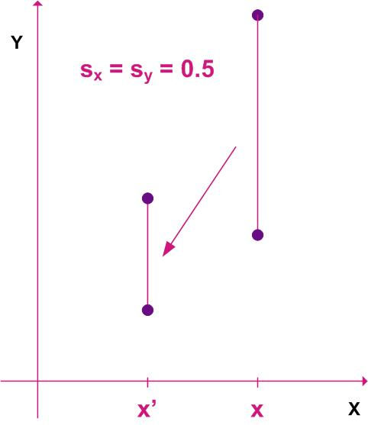
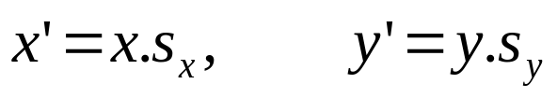
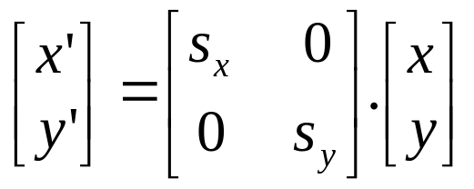
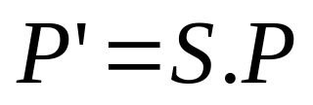
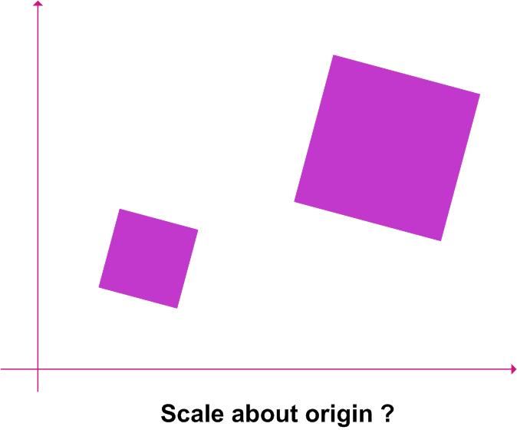
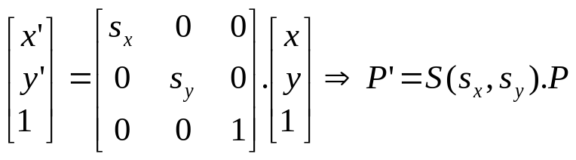
Scaling
In homogeneous co-ordinate

Slide 6
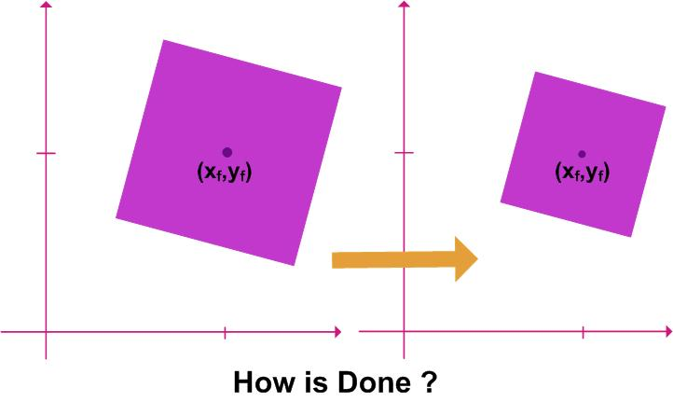
Fixed Point Scaling

Slide 7
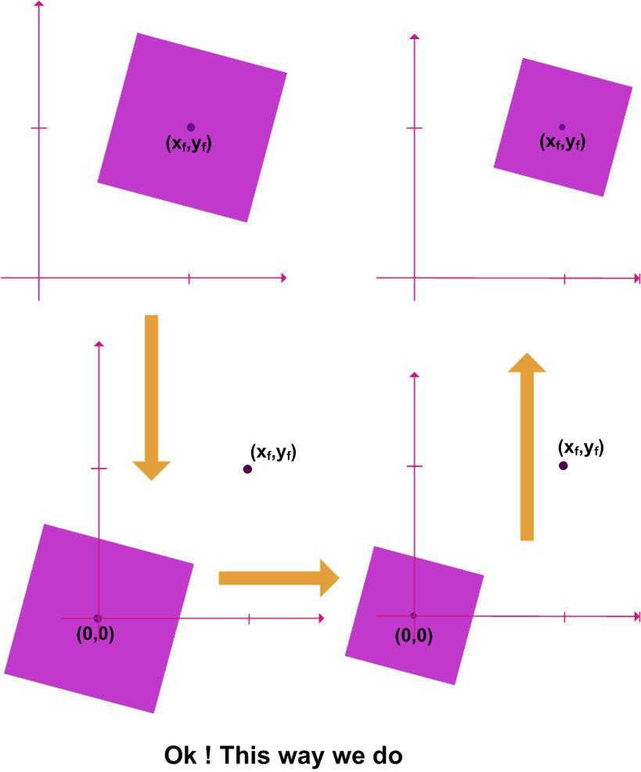
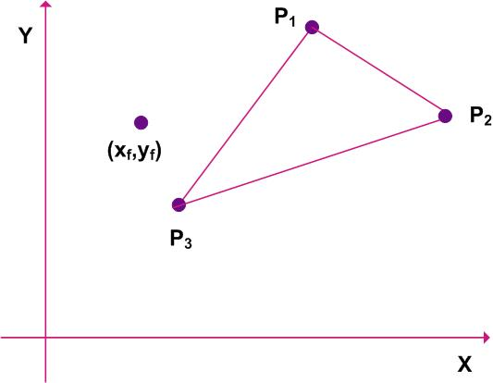
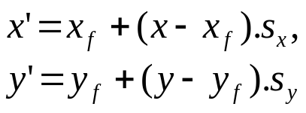
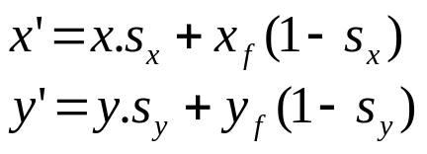
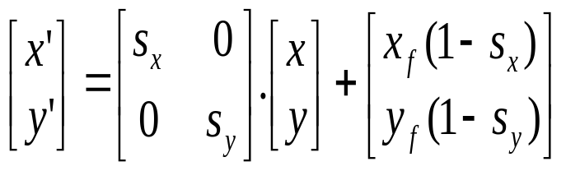
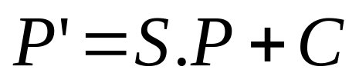
Fixed Point Scaling
j
Additive terms x_{f}(1-s_{x}) and y_{f}(1-s_{y}) are constant for all points in the object

Slide 8
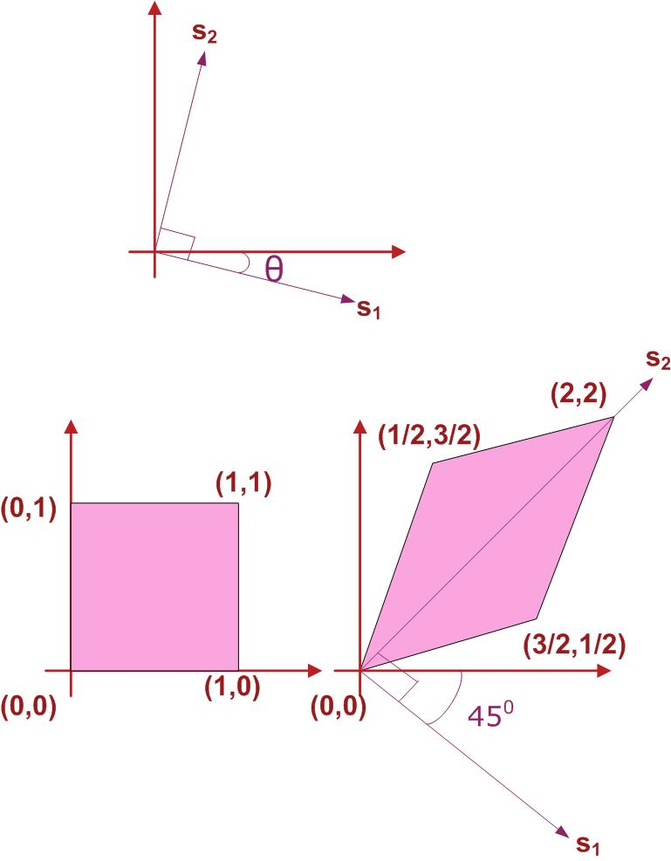

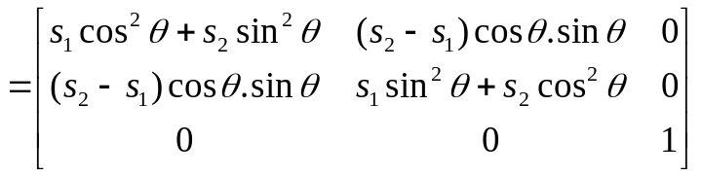
General Scaling Directions
Rotate the object so that x and y axes coincide with s₁ and s₂
Apply scaling transformation in s₁ and s₂ direction
Rotate the object in opposite direction to return points to the original orientations
Example: square converted to parallelogram with s₁=1 and s₂ = 2 and θ = 45⁰ as shown in figure

Slide 9
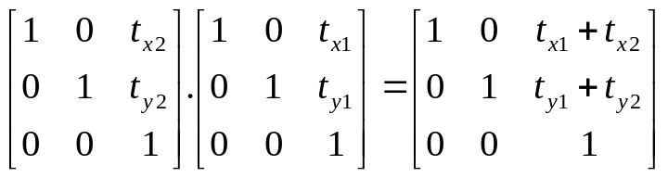
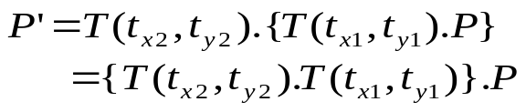
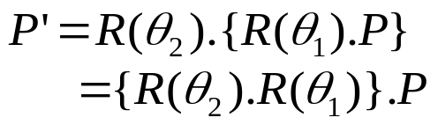

Composite Transformations
For Successive Translation vectors (tx1,ty1) and (tx2,ty2)
Successive Translations are additive
For Successive Rotations θ₁ and θ₂
Successive Rotations are additive.
!!!!!!! PROVE YOURSELF !!!!!!!!!

Slide 10
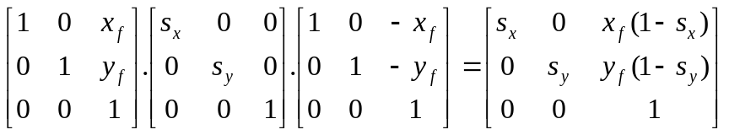
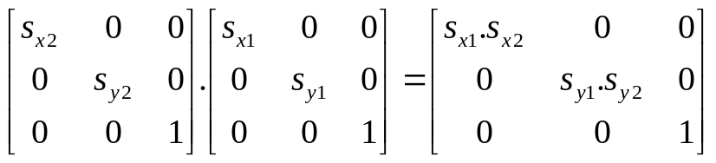
Composite Transformations
Successive Scaling are multiplicative
Fixed Point Scaling
Concatenation Properties
Matrix multiplication is associative, so
A.B.C = (A.B).C = A.(B.C)
Transformation product is not commutative, so
A.B ≠ B.A

Slide 11
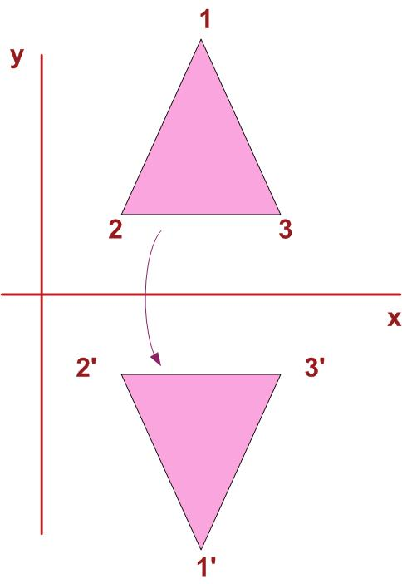
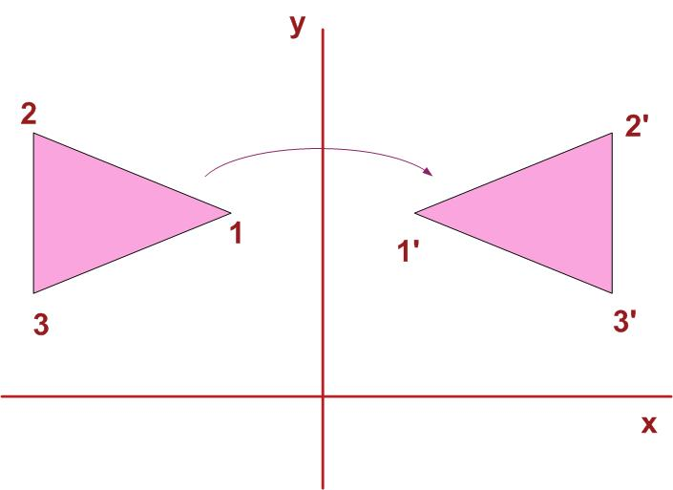
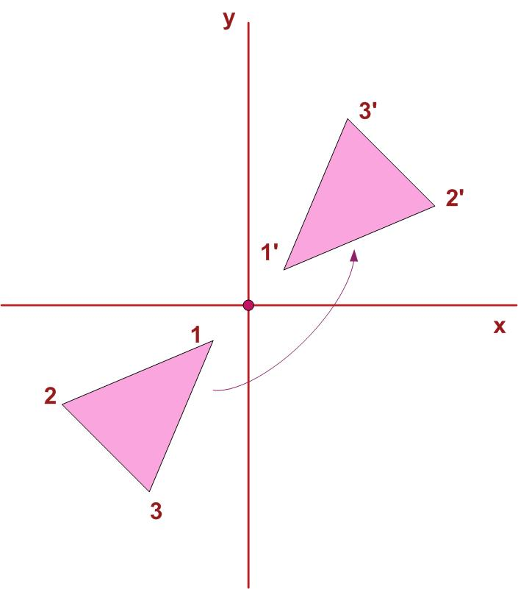
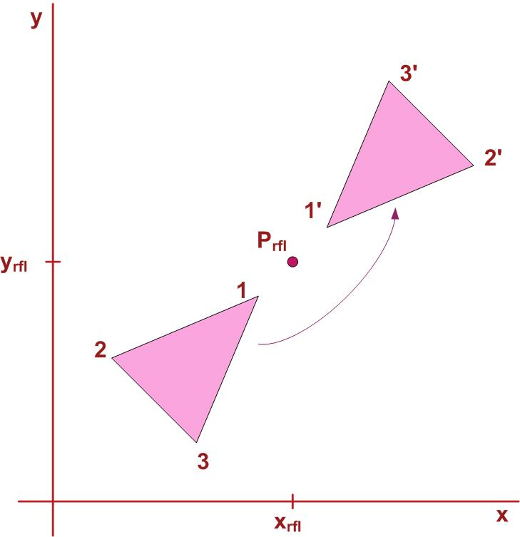
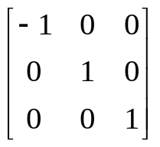
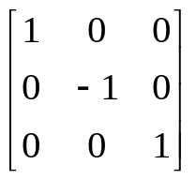
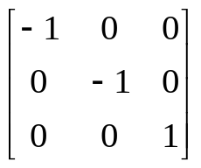
Reflection
Transformation that produces mirror image of an object
Mirror image is produced when rotated 180 degree about axis of reflection
x-axis as axis of reflection
y-axis as axis of reflection
Reflection about origin
Reflection about fixed point

Slide 12
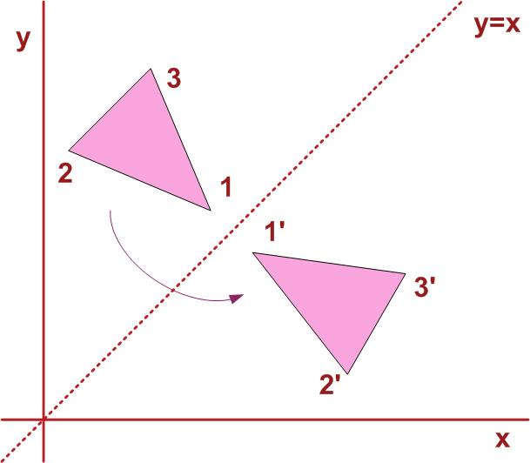
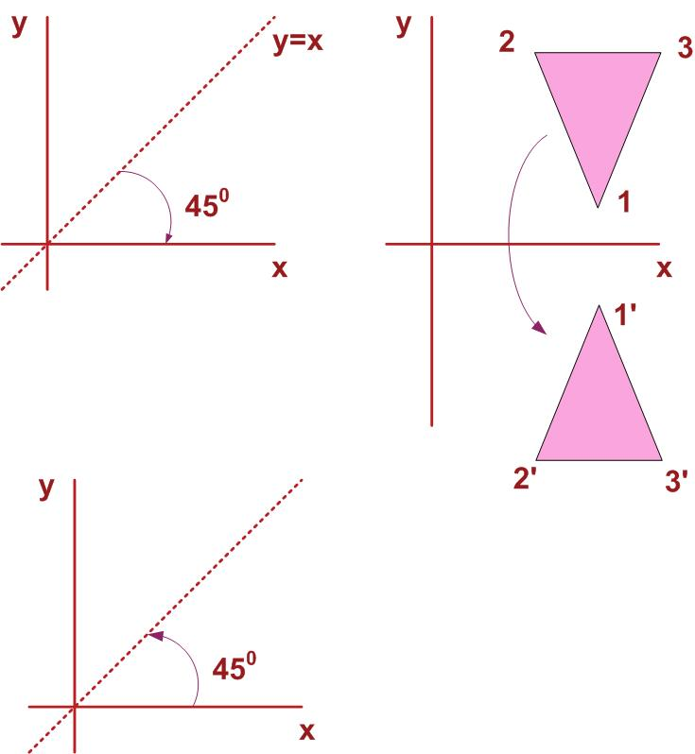
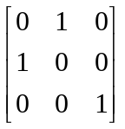
Reflection about a line
h
Reflection about a line y=x can be accomplished in the sequence of left→right→down in the second figure. The reflection matrix is as follows:
Similar sequence could be applied for line y=mx + b

Slide 13
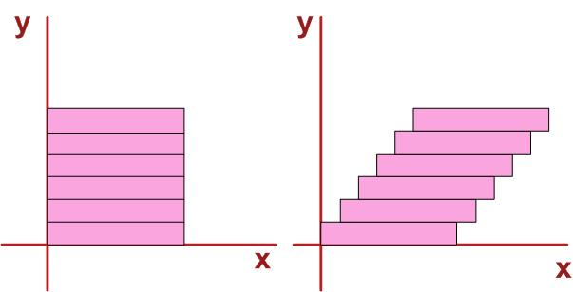
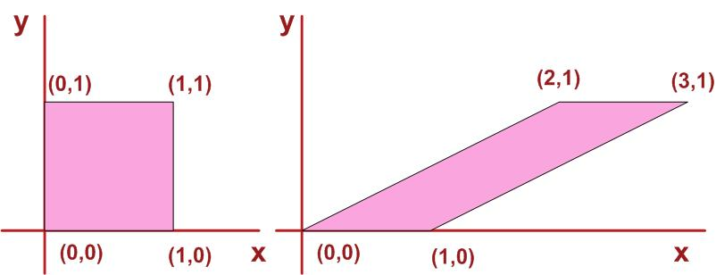
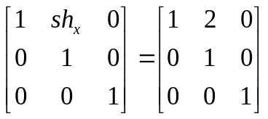
Shear
Transformation that distorts the shape of an object such that Internal layers are shifted w.r.t each other.
Mathematically: For fixed y, all points are shifted by fixed amount in the x-direction
  x’ = x+sh_{x}.y
  y’ = y
All points on reference line (y=0 in figure) stays fixed under transformation
Shear matrix in homogeneous co-ordinate:

Slide 14
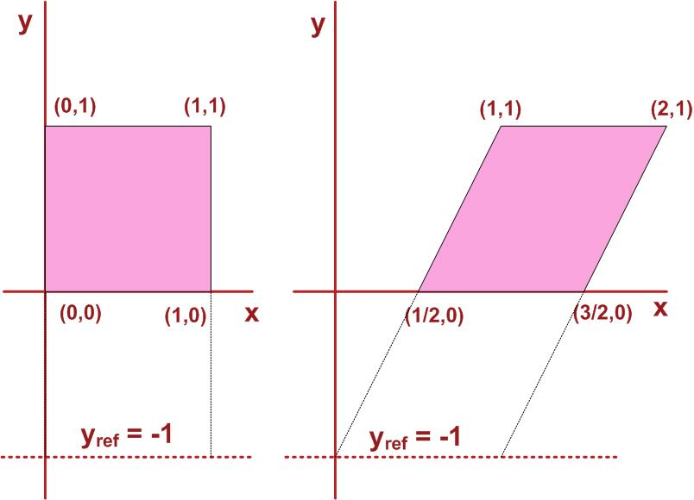



Shear
Shear w.r.t y_{ref} = -1
  x’ = x + sh_{x}(y-y_{ref}), y’ = y
Shear w.r.t x_{ref} = -1
  x’ = x, y’ = y + sh_{y}(x – x_{ref})

